Slide 1
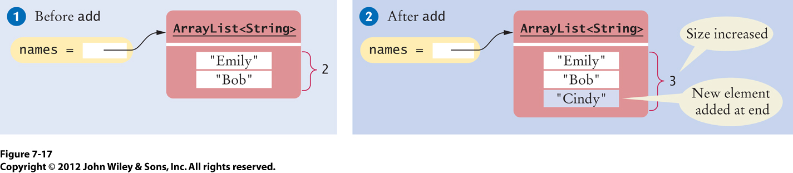
Fig_7-17
ArrayLists…

Slide 2
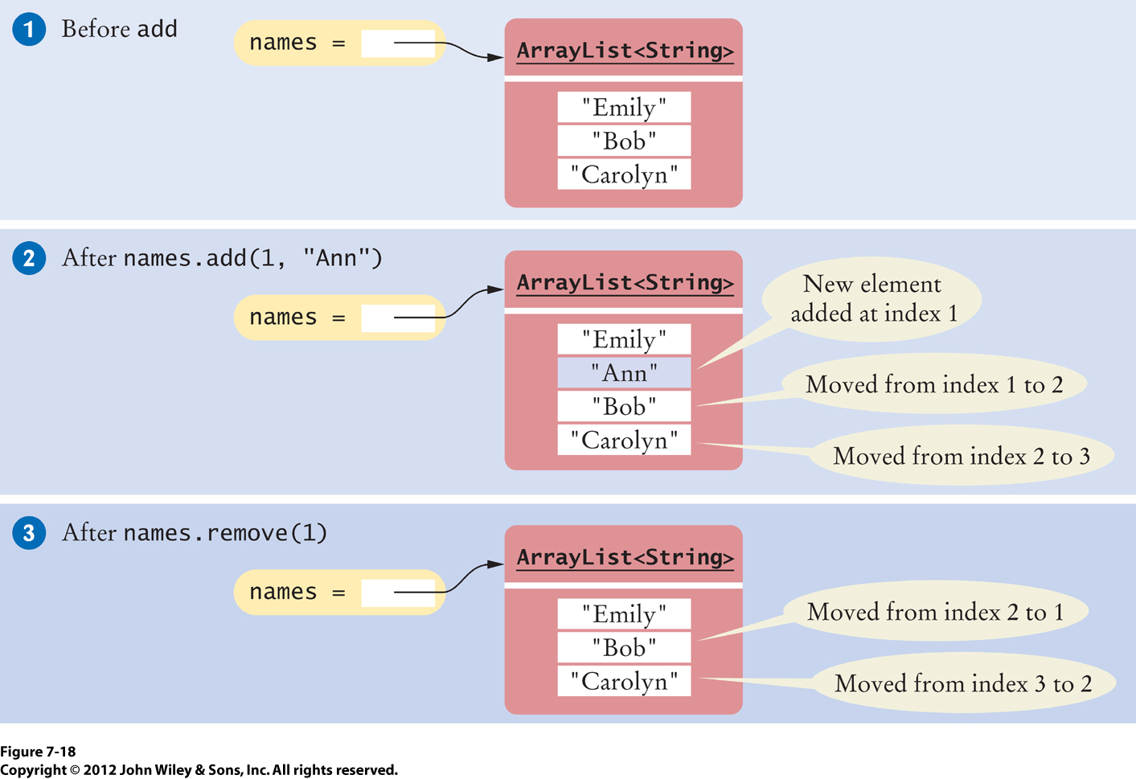
Fig_7-18

Slide 3
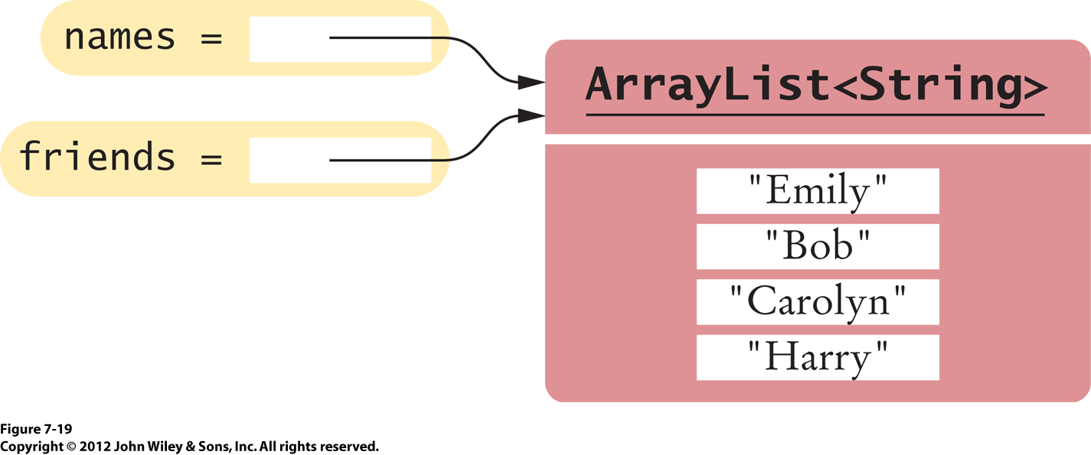
Fig_7-19

Slide 4
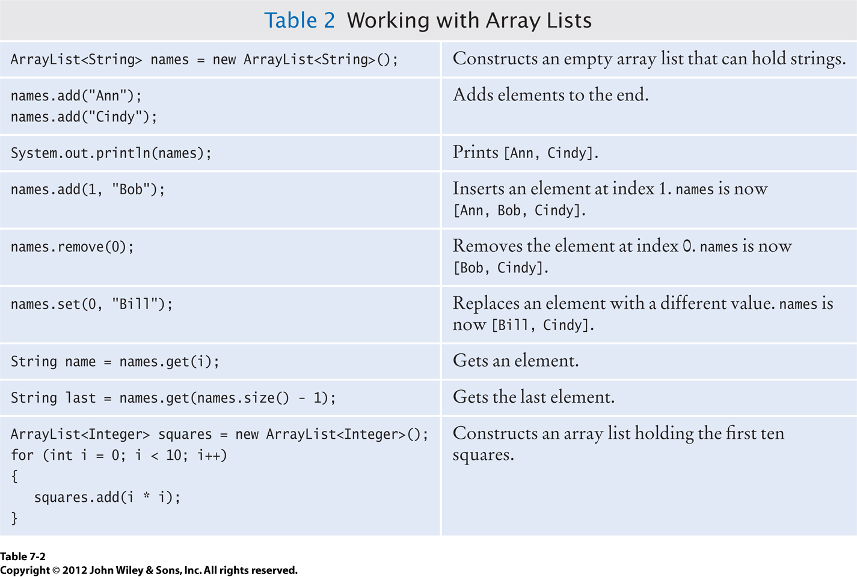
Tab_7-2

Slide 5
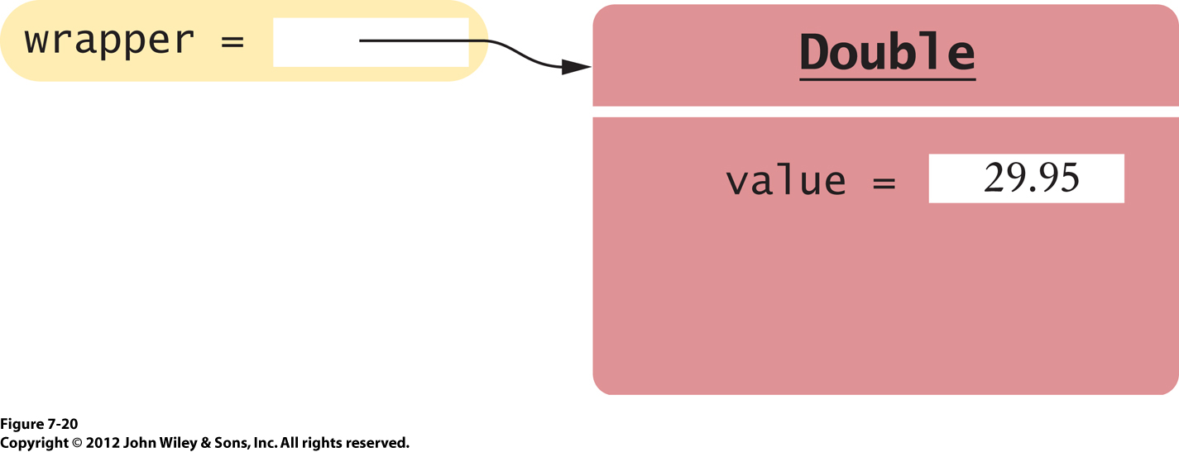
Fig_7-20

Slide 6
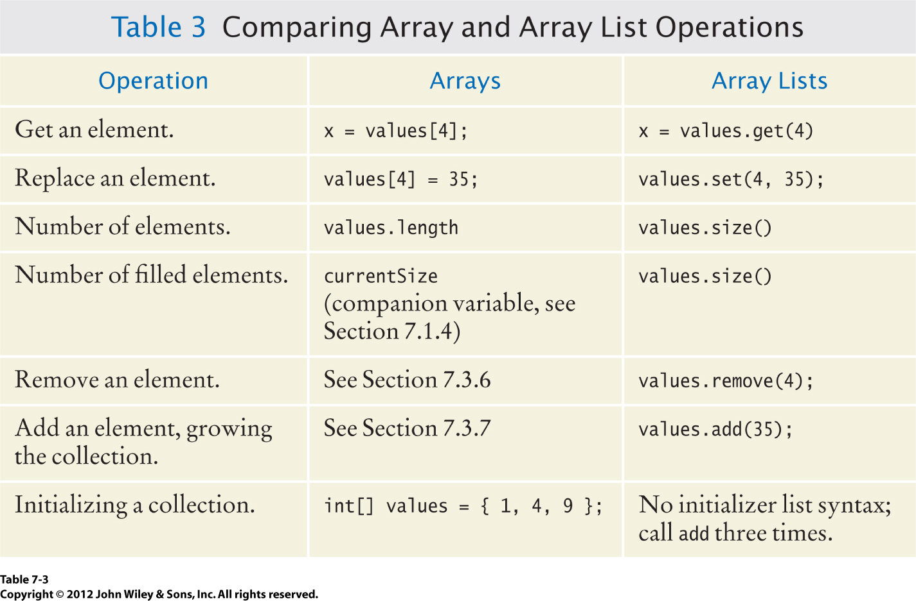
Tab_7-3

Slide 7
To copy an ArrayList…
To make a copy of an array list, construct the copy and pass the original list into the constructor:
ArrayList<String> newNames = new ArrayList<String>(names);

Slide 8
Appending to an ArrayList
public void append(ArrayList<String> target, ArrayList<String> source)
{ for (int i = 0; i < source.size(); i++)
{ target.add(source.get(i)); } }
What are the contents of names1 and names2 after these statements?
ArrayList<String> names1 = new ArrayList<String>();
names1.add("Emily");
names1.add("Bob");
names1.add("Cindy");
ArrayList<String> names2 = new ArrayList<String>();
names2.add("Dave");
append(names1, names2);

Slide 9
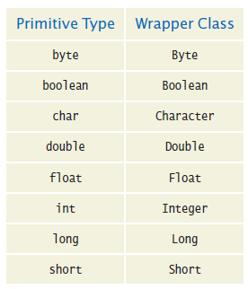
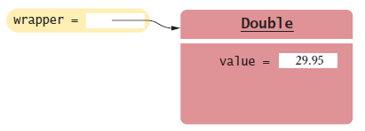
Storing Numbers in ArrayLists
Wrapper Classes
You cannot directly insert primitive type values into array lists.
Like truffles that must be in a wrapper to be sold, a number must be placed in a wrapper to be stored in an array list. Use the matching wrapper class.
Wrapper Classes
To collect double values in an array list, you use an ArrayList<Double>.
if you assign a double value to a Double variable, the number is automatically input into a box, called auto-boxing:
Automatic conversion between primitive types and the corresponding wrapper classes:
Double wrapper = 29.95; Wrapper values are automatically unboxed to primitive types
double x = wrapper;
A Wrapper Class Variable

Slide 10
Practice Problems
What is the value of the count variable after the execution of the given code snippet?
ArrayList<Integer> num = new ArrayList<Integer>(); num.add(1); num.add(2); num.add(1); int count = 0; for (int i = 0; i < num.size(); i++) { if (num.get(i) % 2 == 0)
{ count++; } }

Slide 11
What is the result of this code?
ArrayList<Integer> num1 = new ArrayList<Integer>(); ArrayList<Integer> oddnum = new ArrayList<Integer>();
int data; Scanner in = new Scanner(System.in);
for (int i = 0; i < 10; i++)
{ data = in.nextInt();
num1.add(data);
if (num1.get(i) % 2 != 0)
{ oddnum.add(num1.get(i)); } }

Slide 12
References to ArrayLists
What is happening in the code snippet below?
ArrayList<String> names = new ArrayList<String>(); names.add("John");
names.add("Jerry");
ArrayList<String> friends = names; friends.add("Harry");
What’s the size of each arrayList?

Slide 13
Predict the Output
What is the output of the following statements?
ArrayList<String> names = new ArrayList<String>();
names.add("Bob");
names.add(0, "Ann");
names.remove(1);
names.add("Cal");
names.set(1, "Tony");
for (String s : names)
{ System.out.print(s + ", "); }

Slide 14
Predict
Consider the following code snippet, where the array lists contain elements that are stored in ascending order:
ArrayList<Integer> list1 = new ArrayList<Integer>();
ArrayList<Integer> list2 = new ArrayList<Integer>();
. . .
int count = 0;
for (int i = 0; i < list1.size() && i < list2.size(); i++)
{ if (list1.get(i) == list2.get(i))
{ count++; }
}
Describe what is happening in the given code snippet?

Slide 15
Example of Using an ArrayList
This program reads a sequence of values and prints them, marking the largest value.
*/
public class LargestInArrayList
{ public static void main(String[] args) {
ArrayList<Double> values = new ArrayList<Double>();
// Read inputs
System.out.println("Please enter values, Q to quit:"); Scanner in = new Scanner(System.in); while (in.hasNextDouble()) {
values.add(in.nextDouble()); }
// Find the largest value
double largest = values.get(0); for (int i = 1; i < values.size(); i++) { if (values.get(i) > largest) { largest = values.get(i); } }
// Print all values, marking the largest
for (double element : values) { System.out.print(element); if (element == largest) { System.out.print(" <== largest value"); } System.out.println();
} }
}

Slide 16
Activity with ArrayLists
Activity:
In a single statement, define and initialize a reference variable called myFriends with an ArrayList of Friend objects. Then, add 5 friends to the arrayList of Friends.
Change the phone number of your first friend. Omit the phone entry of your last friend. Display how many friends you have in total, and list them.
Note:
The Friend domain class looks like this:
public class Friend
{ private String firstName;
private String lastName;
private String cellPhoneNumber;
public Friend (String aFirstName, String aLastName, String aCellPhoneNumber)
{ firstName = aFirstName;
lastName = aLastName;
cellPhoneNumber = aCellPhoneNumber;
}
public String getFriendName( )
{
return firstName + “ “ + lastName;
}
public String getCellPhone( )
{
return cellPhoneNumber;
}
}

